Slide 1
The Role of Macrostructure, Foci, and Opportunity Structures

Slide 2
Macro-structure versus micro-structure
What is social structure?
  Distribution of people across social positions
  These distributions influence the chances that people will associate with one another
  Social positions are based on the distinctions people make to differentiate one another
  People occupy multiples social positions at the same time
    Occupations
    Religious Groups
    Communities
    Educational Ranks
    Gender
    Race

Slide 3
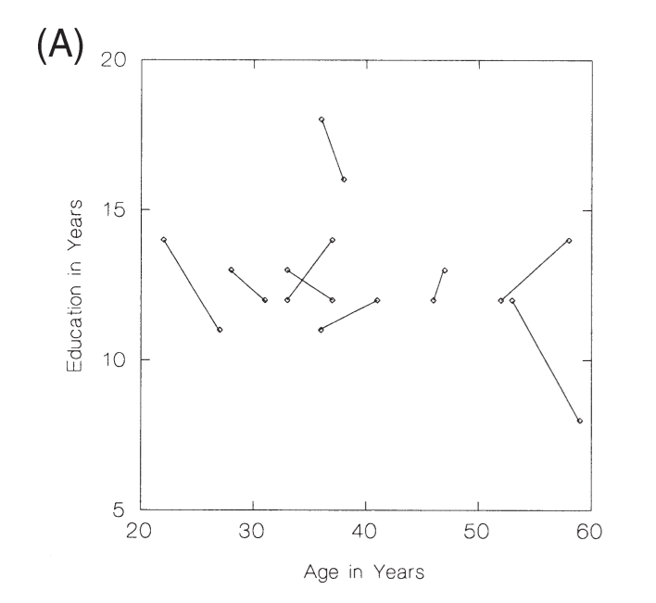
Macro-structure versus micro-structure
Social structure is defined as a multidimensional space within which people are distributed
For each pair of dimensions X₁, X₂:
  there is a probability that persons with a value m on dimension X₁ will come into contact with with persons with a value of n on dimension X₂
This defines the “social relations” between positions: “Macro-structure”
  As distinct from the social relations between people in social network analysis
    “Micro-structure”

Slide 4
Macro-structure versus micro-structure
Dimensions in multidimensional “Blau space” are called “parameters”
  Parameters are social distinctions that make a difference when it comes to association
Some distinctions are categorical, with no inherent ordering
  Gender, Race, Religion
    Nominal parameters
Some distinctions are rank-ordered:
  Education, Age, Income, Occupational Prestige
    Graduated parameters

Slide 5
Macro-structure versus micro-structure
Societies can be differentiated by the extent to which people are equally or unequally distributed across dimensions
  Heterogeneity
    The extent to which people are equally/unequally distributed around nominal parameters
  Inequality
    The extent to which people are equally/unequally distributed around graduated parameters

Slide 6
Macro-structure versus micro-structure
Dimensions of social association are not orthogonal but are in fact correlated
  Correlation among dimensions is another signature difference between different types of macro-structure
    Education and Income
    Race and Education
    Age and Income
    Religion and Education
  Nominal/graduated correlations pertain to status differences across groups
  Graduated/graduated correlations pertain to status consolidation in a society

Slide 7
Macro-structure versus micro-structure
All things equal, the more heterogeneity and the more inequality the less integration in the society
  Persons are more likely to associate with same-category members in nominal parameters
    X₁ = X₂
      E.g. Race “homophily”
  Persons are more likely to associate with proximate others in graduated parameters
    X₁ - X₂ ≅ 0
      E.g. Educational “homogamy” in marriage

Slide 8
Macro-structure versus micro-structure
Conversely, social integration depends on intergroup relations
  Ideal type “caste” system
    Only within status relations and no cross-status relations
  Ideal type stratification system
    Perfect correlation between nominal and graduated parameters
  Ideal type “open” system
    Equal probabilities of associating regardless of social position
    No correlations between nominal and graduated parameters
  Most real systems fall in-between
    Tendency towards homophily but also cross-group relations
    Correlations between nominal and graduated parameters: > 0 < 1

Slide 9

Blau’s rules: Group size effects
If a nominal parameter divides the population into two or more groups:
  Members of numerically smaller groups will be proportionally more likely to have relations with majority group members
  As group size inequality increases members of the majority group will tend to have almost exclusively ingroup relations
    Minorities benefit from outgroup ties?
      Social diversity
      Diversity of intellectual/cultural outlook

Slide 10
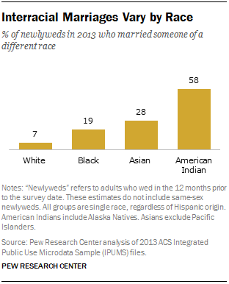
Blau’s rules: Group size effects
If a nominal parameter divides the population into two or more groups:
  Members of numerically smaller groups will be proportionally more likely to have relations with majority group members
  As group size inequality increases members of the majority group will tend to have almost exclusively ingroup relations
    Minorities benefit from outgroup ties?
      Social diversity
      Diversity of intellectual/cultural outlook

Slide 11
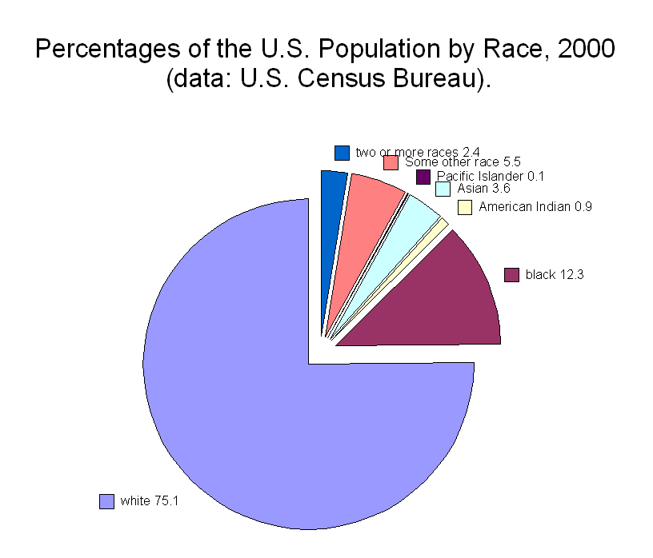
Blau’s rules: Group size effects
If a nominal parameter divides the population into two or more groups:
  Members of numerically smaller groups will be proportionally more likely to have relations with majority group members
  As group size inequality increases members of the majority group will tend to have almost exclusively ingroup relations
    Minorities benefit from outgroup ties?
      Social diversity
      Diversity of intellectual/cultural outlook

Slide 12

Blau’s rules: Multiform heterogeneity effects
Example:
  In the U.S. there are systematic correlations between religion and race
This means that:
  Choosing contacts based on race leads to biases in the representation of people of certain religions at the micro-structural level (And vice-versa)
Accordingly:
  Can’t conclude that people prefer same (race/religion) contacts from micro-level observations of homogeneity!

Slide 13
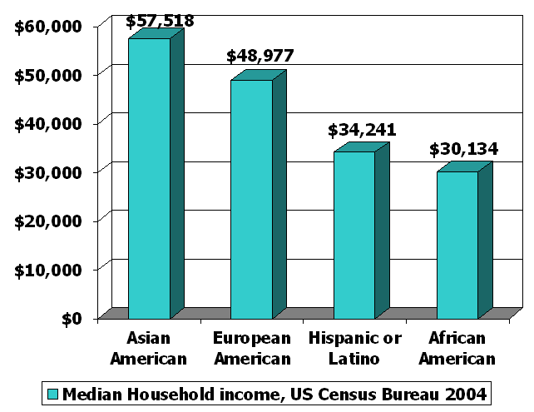
Blau’s rules: Multiform heterogeneity effects
This applies to any correlation between dimensions of association
  Same race associational preference may lead to higher/lower representation of people different social classes at the micro-structural level
With negative correlations it goes the other way
  More diversity at the micro-level that we would expect
    E.g. Age and education

Slide 14

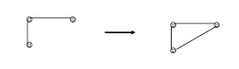
Focused organizations of social ties
Where do social ties come from?
  One answer: Inherent tendencies within social networks:
    Clustering or transitivity
From common relation to relation

Slide 15

Focused organizations of social ties
One observation:
  Often social relations are organized around “circles,” or “common activities”
  These “foci” may themselves be a primary driver of which relations show up in people’s networks
What is a “focus”?
  “ a social, psychological, legal, or physical entity around which joint activities are organized (e.g., workplaces, voluntary organizations, hangouts, families, etc.” (Feld 1981: 1016)

Slide 16

Focused organizations of social ties
This suggests two new mechanisms for where ties come from:
From circle to relation
From common activity to relation

Slide 17
Focused organizations of social ties
Foci vary around several dimensions
  Levels of “constraint”
    Time and energy that they require
  Size
Foci may emerge from pre-existing relations
  Friends form clubs, participate in common activities
Individuals generally belong to multiple intersecting foci
  “Cross-cutting” circles
  Clustering at the ego-network level may be the result of constraining overlapping foci

